Slide 1
2024 Employee Benefits Renewal
Information Presentation

Slide 2

What’s New for 2024!
Medical Plan We are changing our medical plan from AmeriHealth to Aetna. Employees living in NJ will have an Aetna Whole Health Plan offering with a narrow network and richer benefits for Tier 1, and access to Aetna’s extensive national provider network for Tier 2. Non-NJ employees will have an in-network only plan with similar benefits.
Health Reimbursement Account – Adding Vision Reimbursement. The Vision Reimbursement will be $150 for the year per enrolled member.
Health Reimbursement Account - If you are new to the plan or have had the VISA Debit Card for 3 years, you will receive a VISA Debit Card from The Seneca Group pre loaded with Medical Funds of $6,900 Single, $13,800 Single + 1 or more dependents and Dental funds of $1,500 per enrolled member.
Flexible spending Account We will also continue to offer the Flexible Spending Account (FSA) administered through Seneca. You may elect to up to $3,200 for the medical F.S.A and $5,000 for the Dependent Care Account for the 2024 FSA plan year.

Slide 3
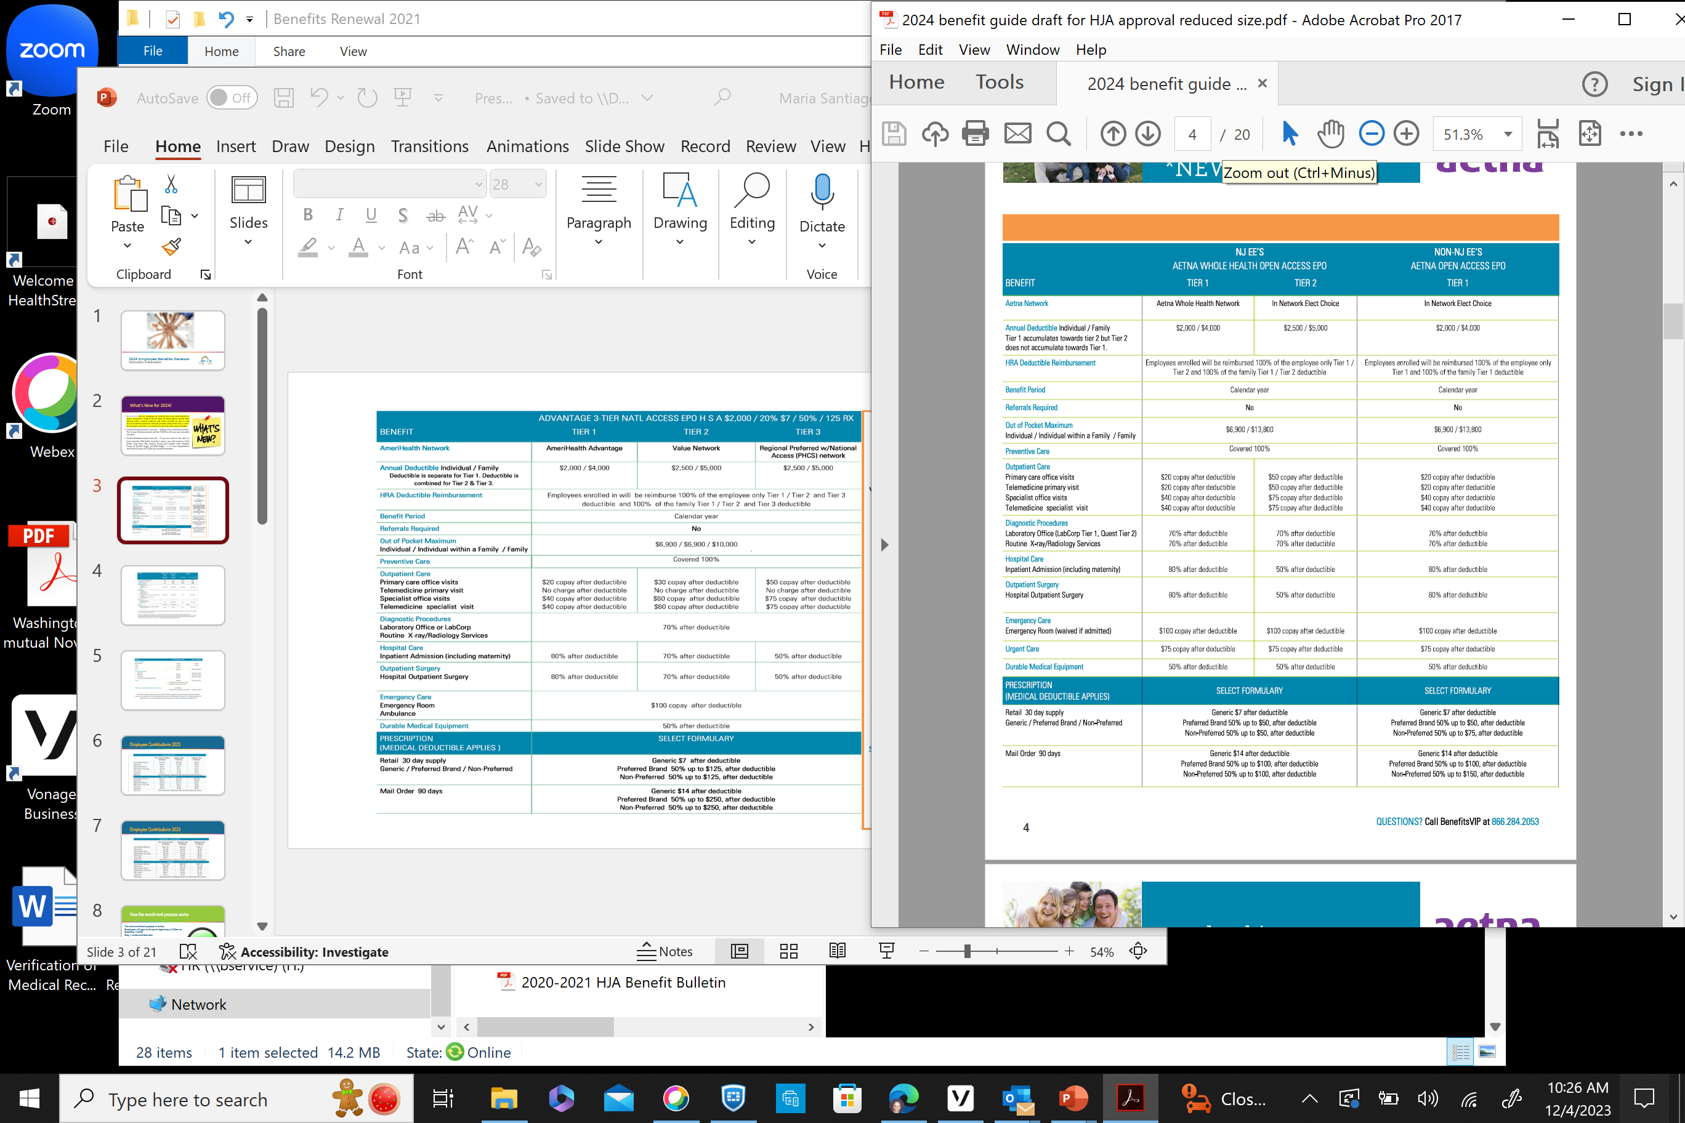

Slide 4
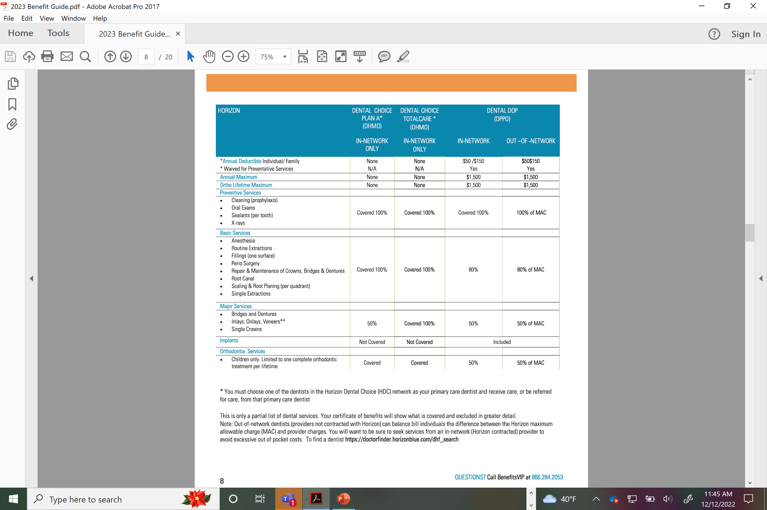

Slide 5
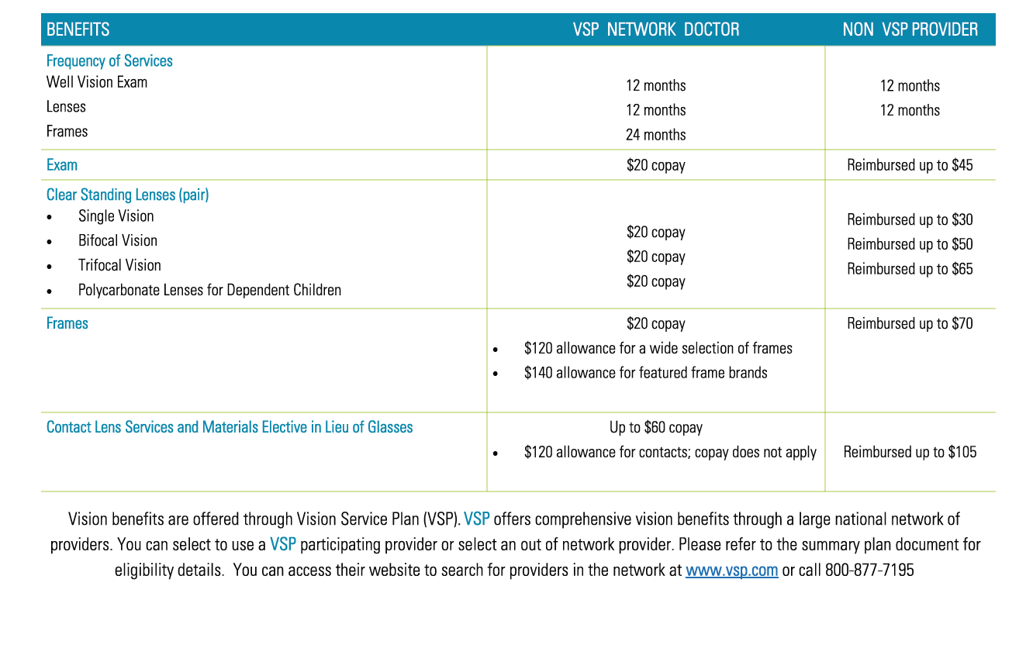

Slide 6
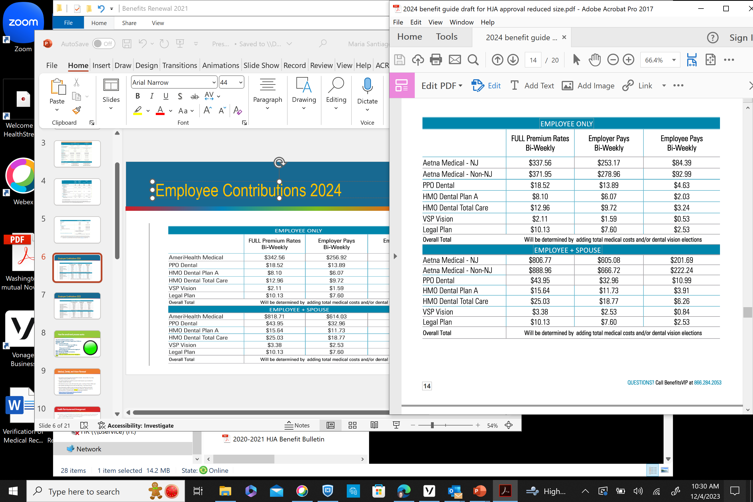
Employee Contributions 2024

Slide 7
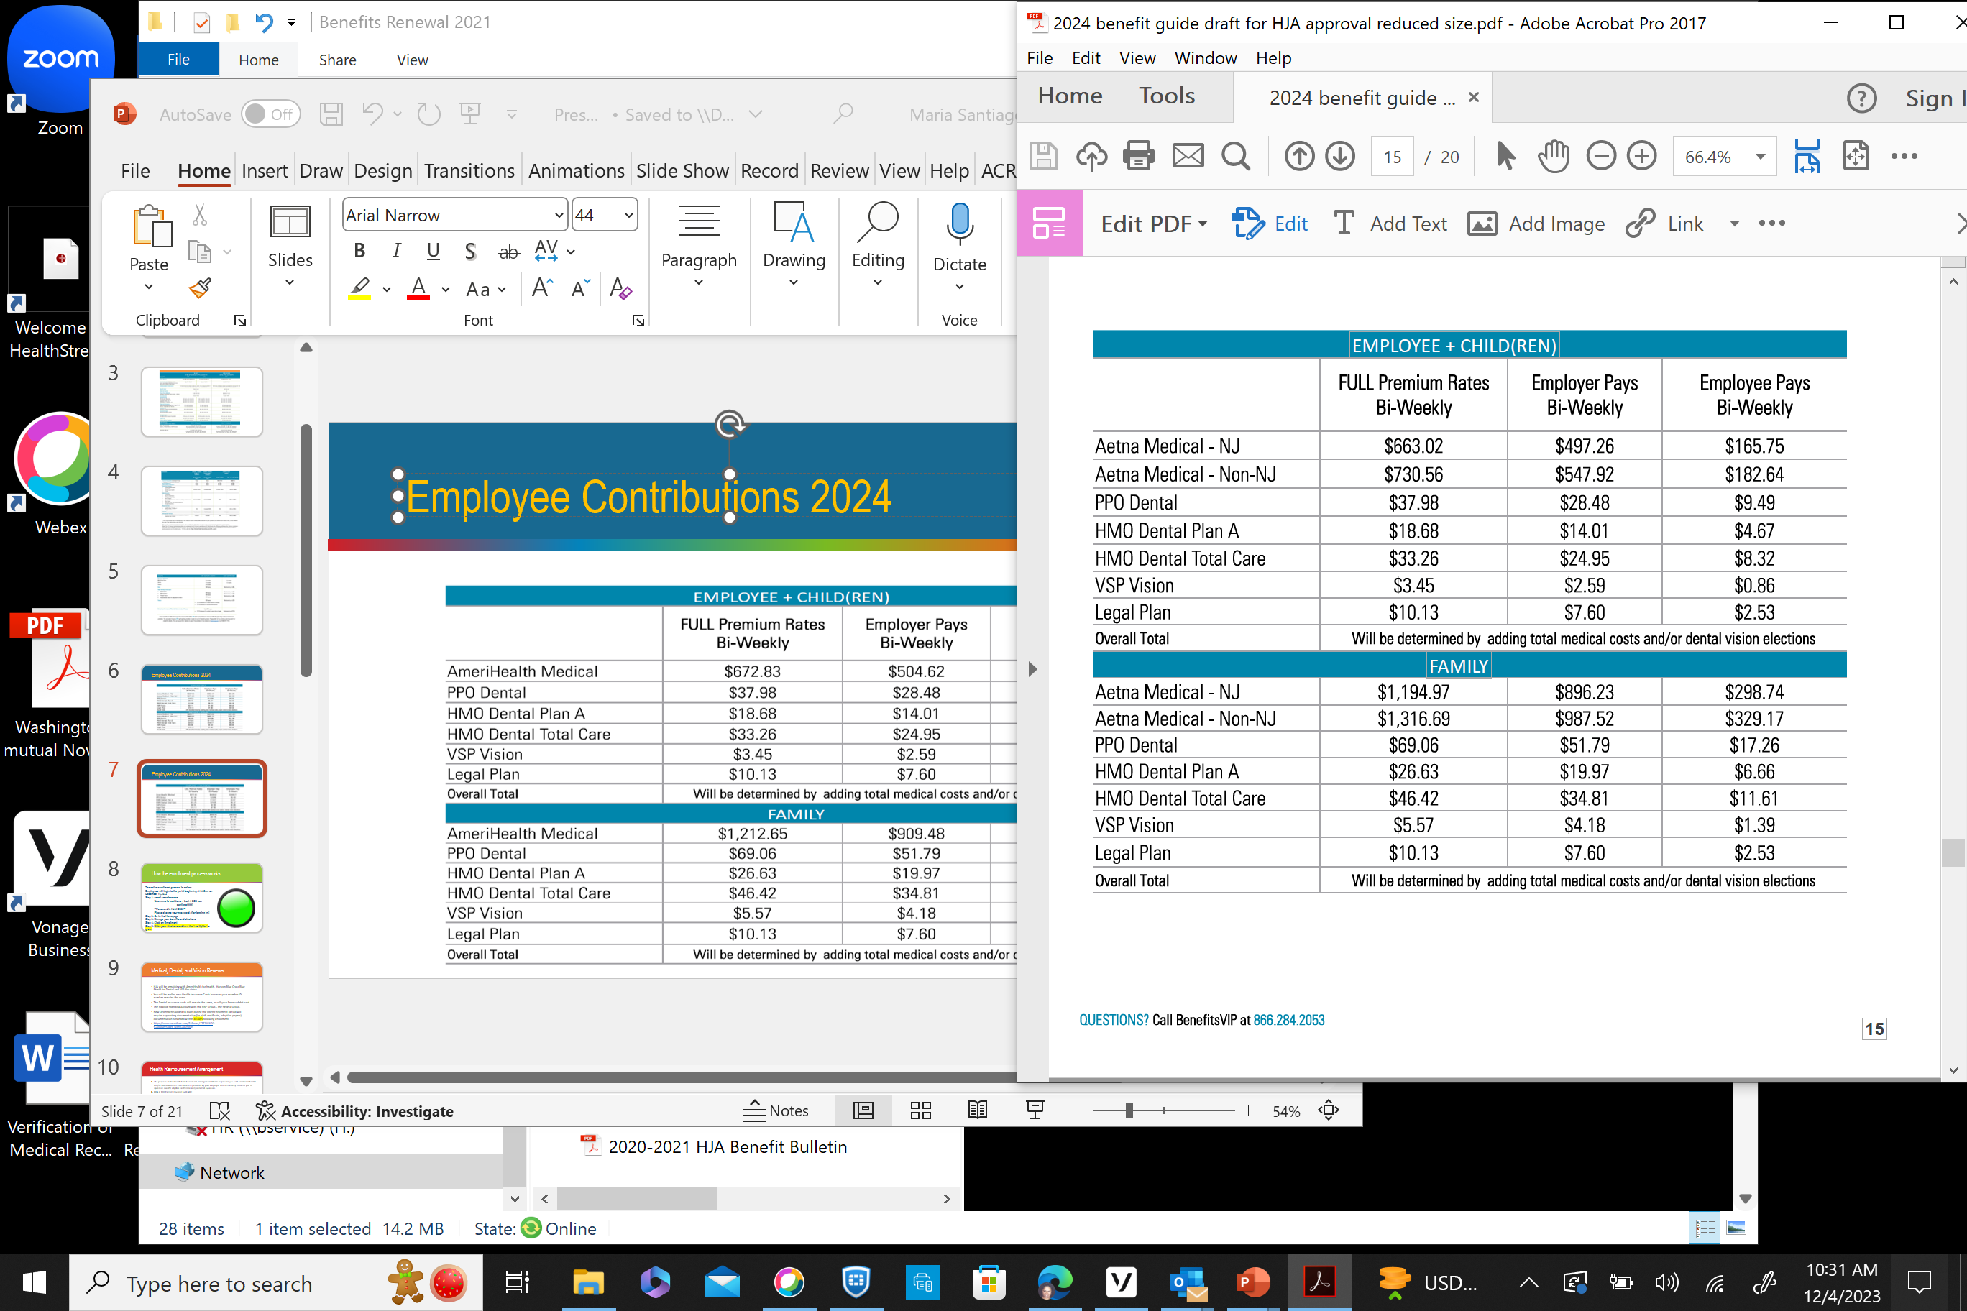
Employee Contributions 2024

Slide 8

How the enrollment process works
The entire enrollment process in online:
Employees will login to the portal beginning at 8:30am on December 6, 2023
Step 1: enroll.smartben.com
Username is LastName + Last 4 SSN (ex:
santiago####)
**Password is HJAHC321**
Please change your password after logging in!!
Step 2: Go to the Homepage
Step 3: Manage your benefits and elections
Step 4: Click on Enrollment
Step 5: Make your elections and turn the “red lights” to green

Slide 9
Medical, Dental, and Vision Renewal
HJA will be switching Medical coverage from AmeriHealth for health to Aetna, Horizon Blue Cross Blue Shield for Dental and VSP for vision. Medical and FSA is an active enrollment. You must elect or waive.
You will be mailed new Health Insurance Cards.
The Dental insurance cards will remain the same, as will your Seneca debit card.
The Flexible Spending Account with the HRP Group… the Seneca Group.
New Dependents added to plans during the Open Enrollment period will require supporting documentation (i.e birth certificate, adoption papers); documentation is needed within 30 days following enrollment.
https://hjahc-my.sharepoint.com/personal/maria_santiago_henryjaustin_org/Documents/Microsoft%20Teams%20Chat%20Files/Processing%20Cover%20Sheet.pdf

Slide 10
Health Reimbursement Arrangement
The purpose of the Health Reimbursement Arrangement Plan is to provide you with additional health and/or dental benefits. This benefit is provided by your employer and sets money aside for you to spend on specific eligible healthcare and/or dental expenses.
HRA is 100 Percent Covered by HJAHC
Covers all eligible out of pocket costs for employee and covered dependents for Medical, Dental and now Vision!
HRA covers all eligible Tier 1 and Tier 2 in network only costs.

Slide 11
How Health Reimbursement Arrangement Works
Aetna will always pay first; when you go to the doctor, have them bill Aetna. It is your responsibility to make sure all claims are processed through Aetna first.
The Seneca Group will pay second, covering any remaining balance; use your Seneca debit card to pay the bill the medical provider sends to you.
You submit the Notification from The Seneca Group with the supporting Explanation of Benefits (EOB); this demonstrates that you have already processed the claim through AmeriHealth, and that it is a covered expense, or you may elect the EOB Harvesting. Plan Members will have access to a new enhanced method for providing the required documentation for HRA (and FSA) plan substantiation. This will allow members to send their EOB’s directly from the carrier to The Seneca Group without any work required from the member. Enrollment is optional and a separate email will be sent to all plan members for access to enroll in this new option if desired.
You will not pay out of pocket for anything, so long as it is a covered visit/ procedure. For more information on coverage, please visit: https://www.aetna.com

Slide 12
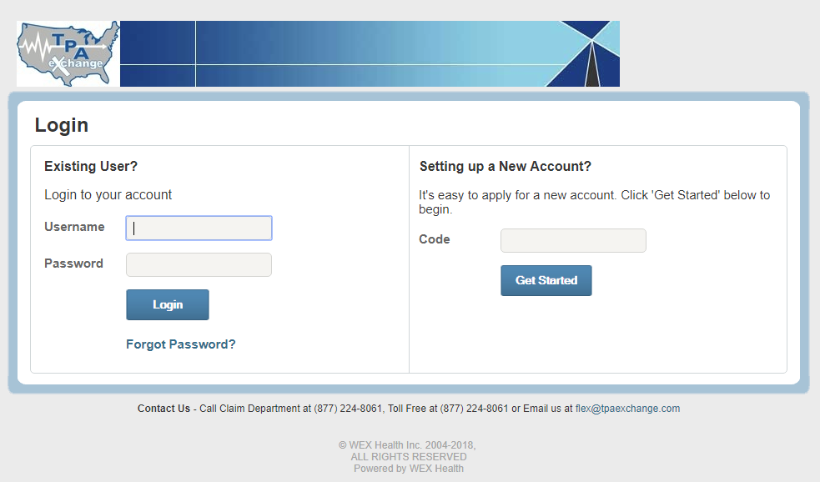
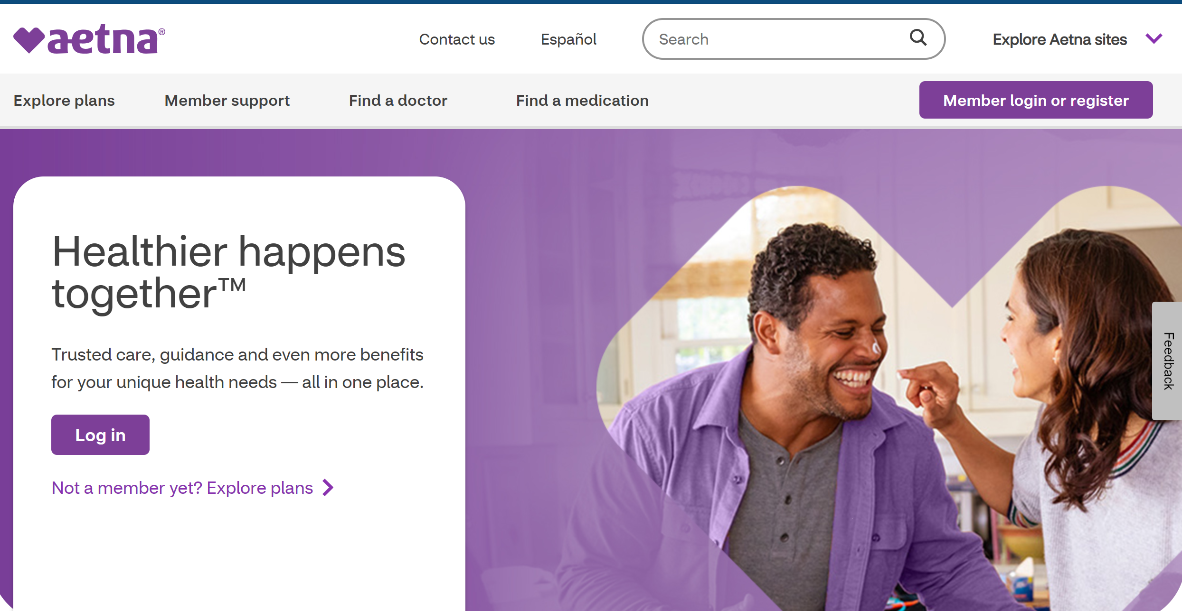
Two Step System
How Health Reimbursement Arrangement Works
Test
Words
Notification for Services Rendered/ Paid
Explanation of Benefits (EOB)

Slide 13
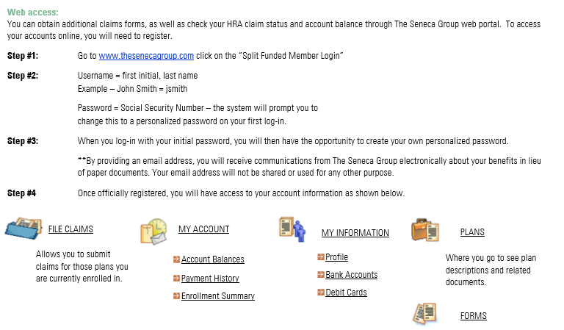
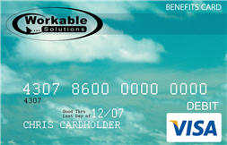
How to Access Seneca Online

Slide 14
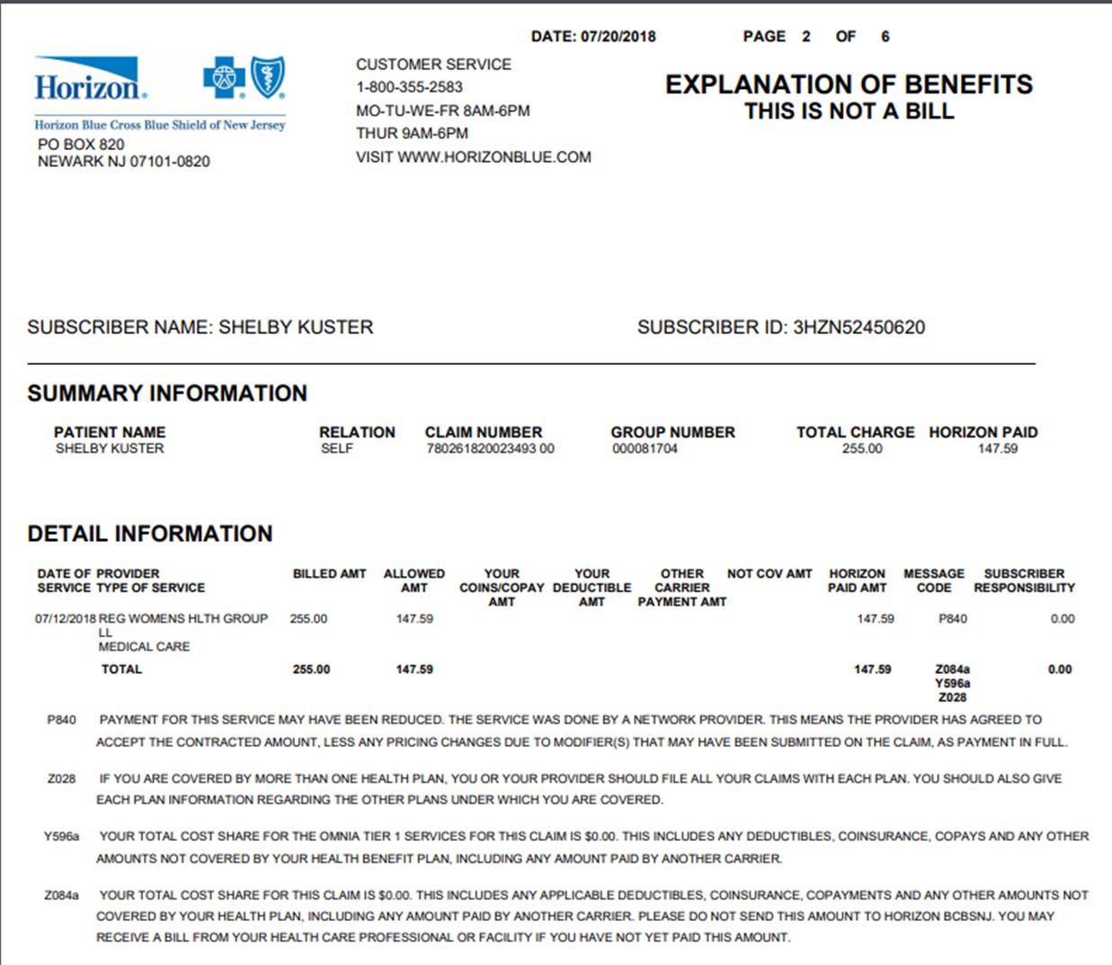
Title

Slide 15
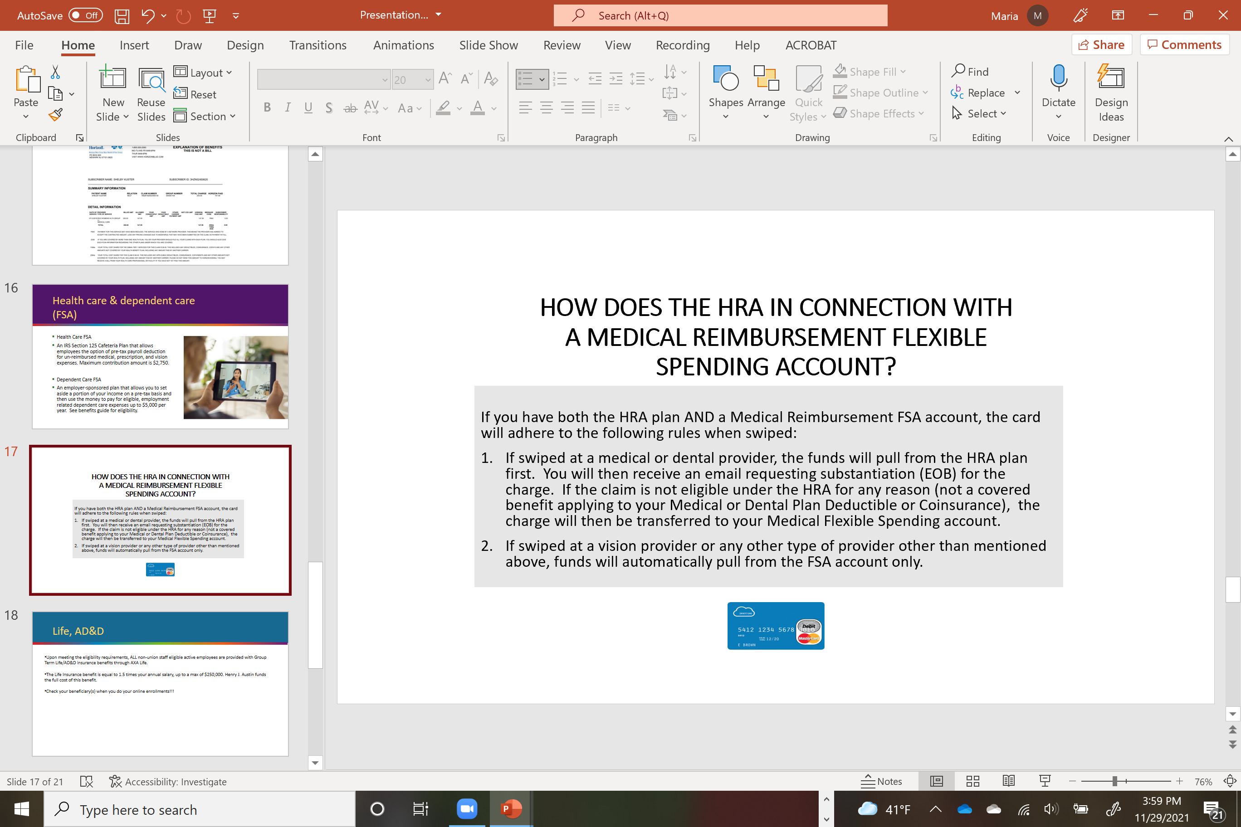
Health Care & Dependent Care
(FSA)
Health Care FSA
An IRS Section 125 Cafeteria Plan that allows employees the option of pre-tax payroll deduction for un-reimbursed medical, prescription, and vision expenses. Maximum contribution amount is $3,200.
Dependent Care FSA
An employer-sponsored plan that allows you to set aside a portion of your income on a pre-tax basis and then use the money to pay for eligible, employment related dependent care expenses up to $5,000 per year. See benefits guide for eligibility.

Slide 16
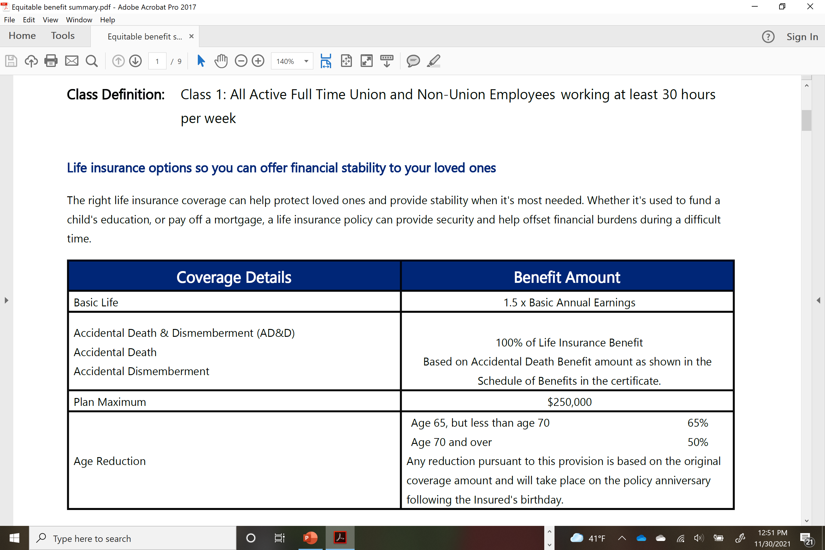
Life Insurance and Accidental Death & Dismemberment Insurance
Upon meeting the eligibility requirements, ALL staff eligible active employees are provided with Group Term Life and AD&D insurance benefits through Equitable insurance company.
The Life Insurance benefit is equal to 1.5 times your annual salary, up to a max of $250,000. Henry J. Austin funds the full cost of this benefit. At age of 65 the benefit begins to reduce.
This is no extra cost to you to employee!!!
Please check, choose or update your beneficiary(s) when you do your online enrollments!!!

Slide 17

Other Employee Benefits
An Employee Assistance Program (EAP) through ComPsych ® Guidance Resources is also available to all eligible, full-time employees
Emergency Travel Assistance Program (TA) administered by AXA Assistance USA, Inc. It is also available to all eligible, full-time employees. Visit: http://accounts.travel-eye-axa.com/en/registration/axa-us
These benefits no extra cost to you the employee.

Slide 18
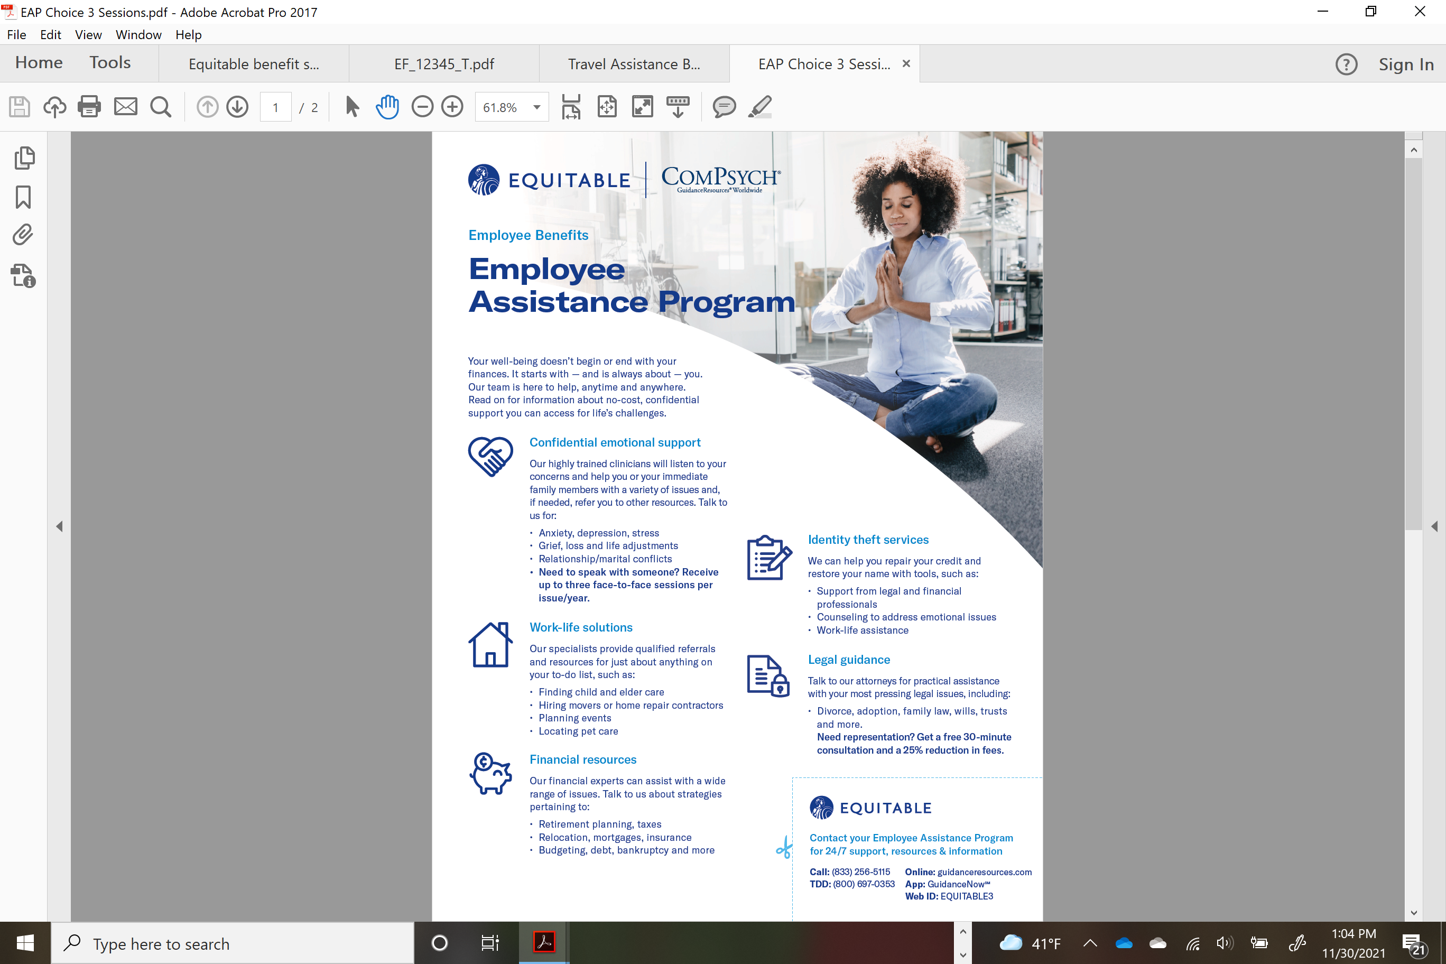
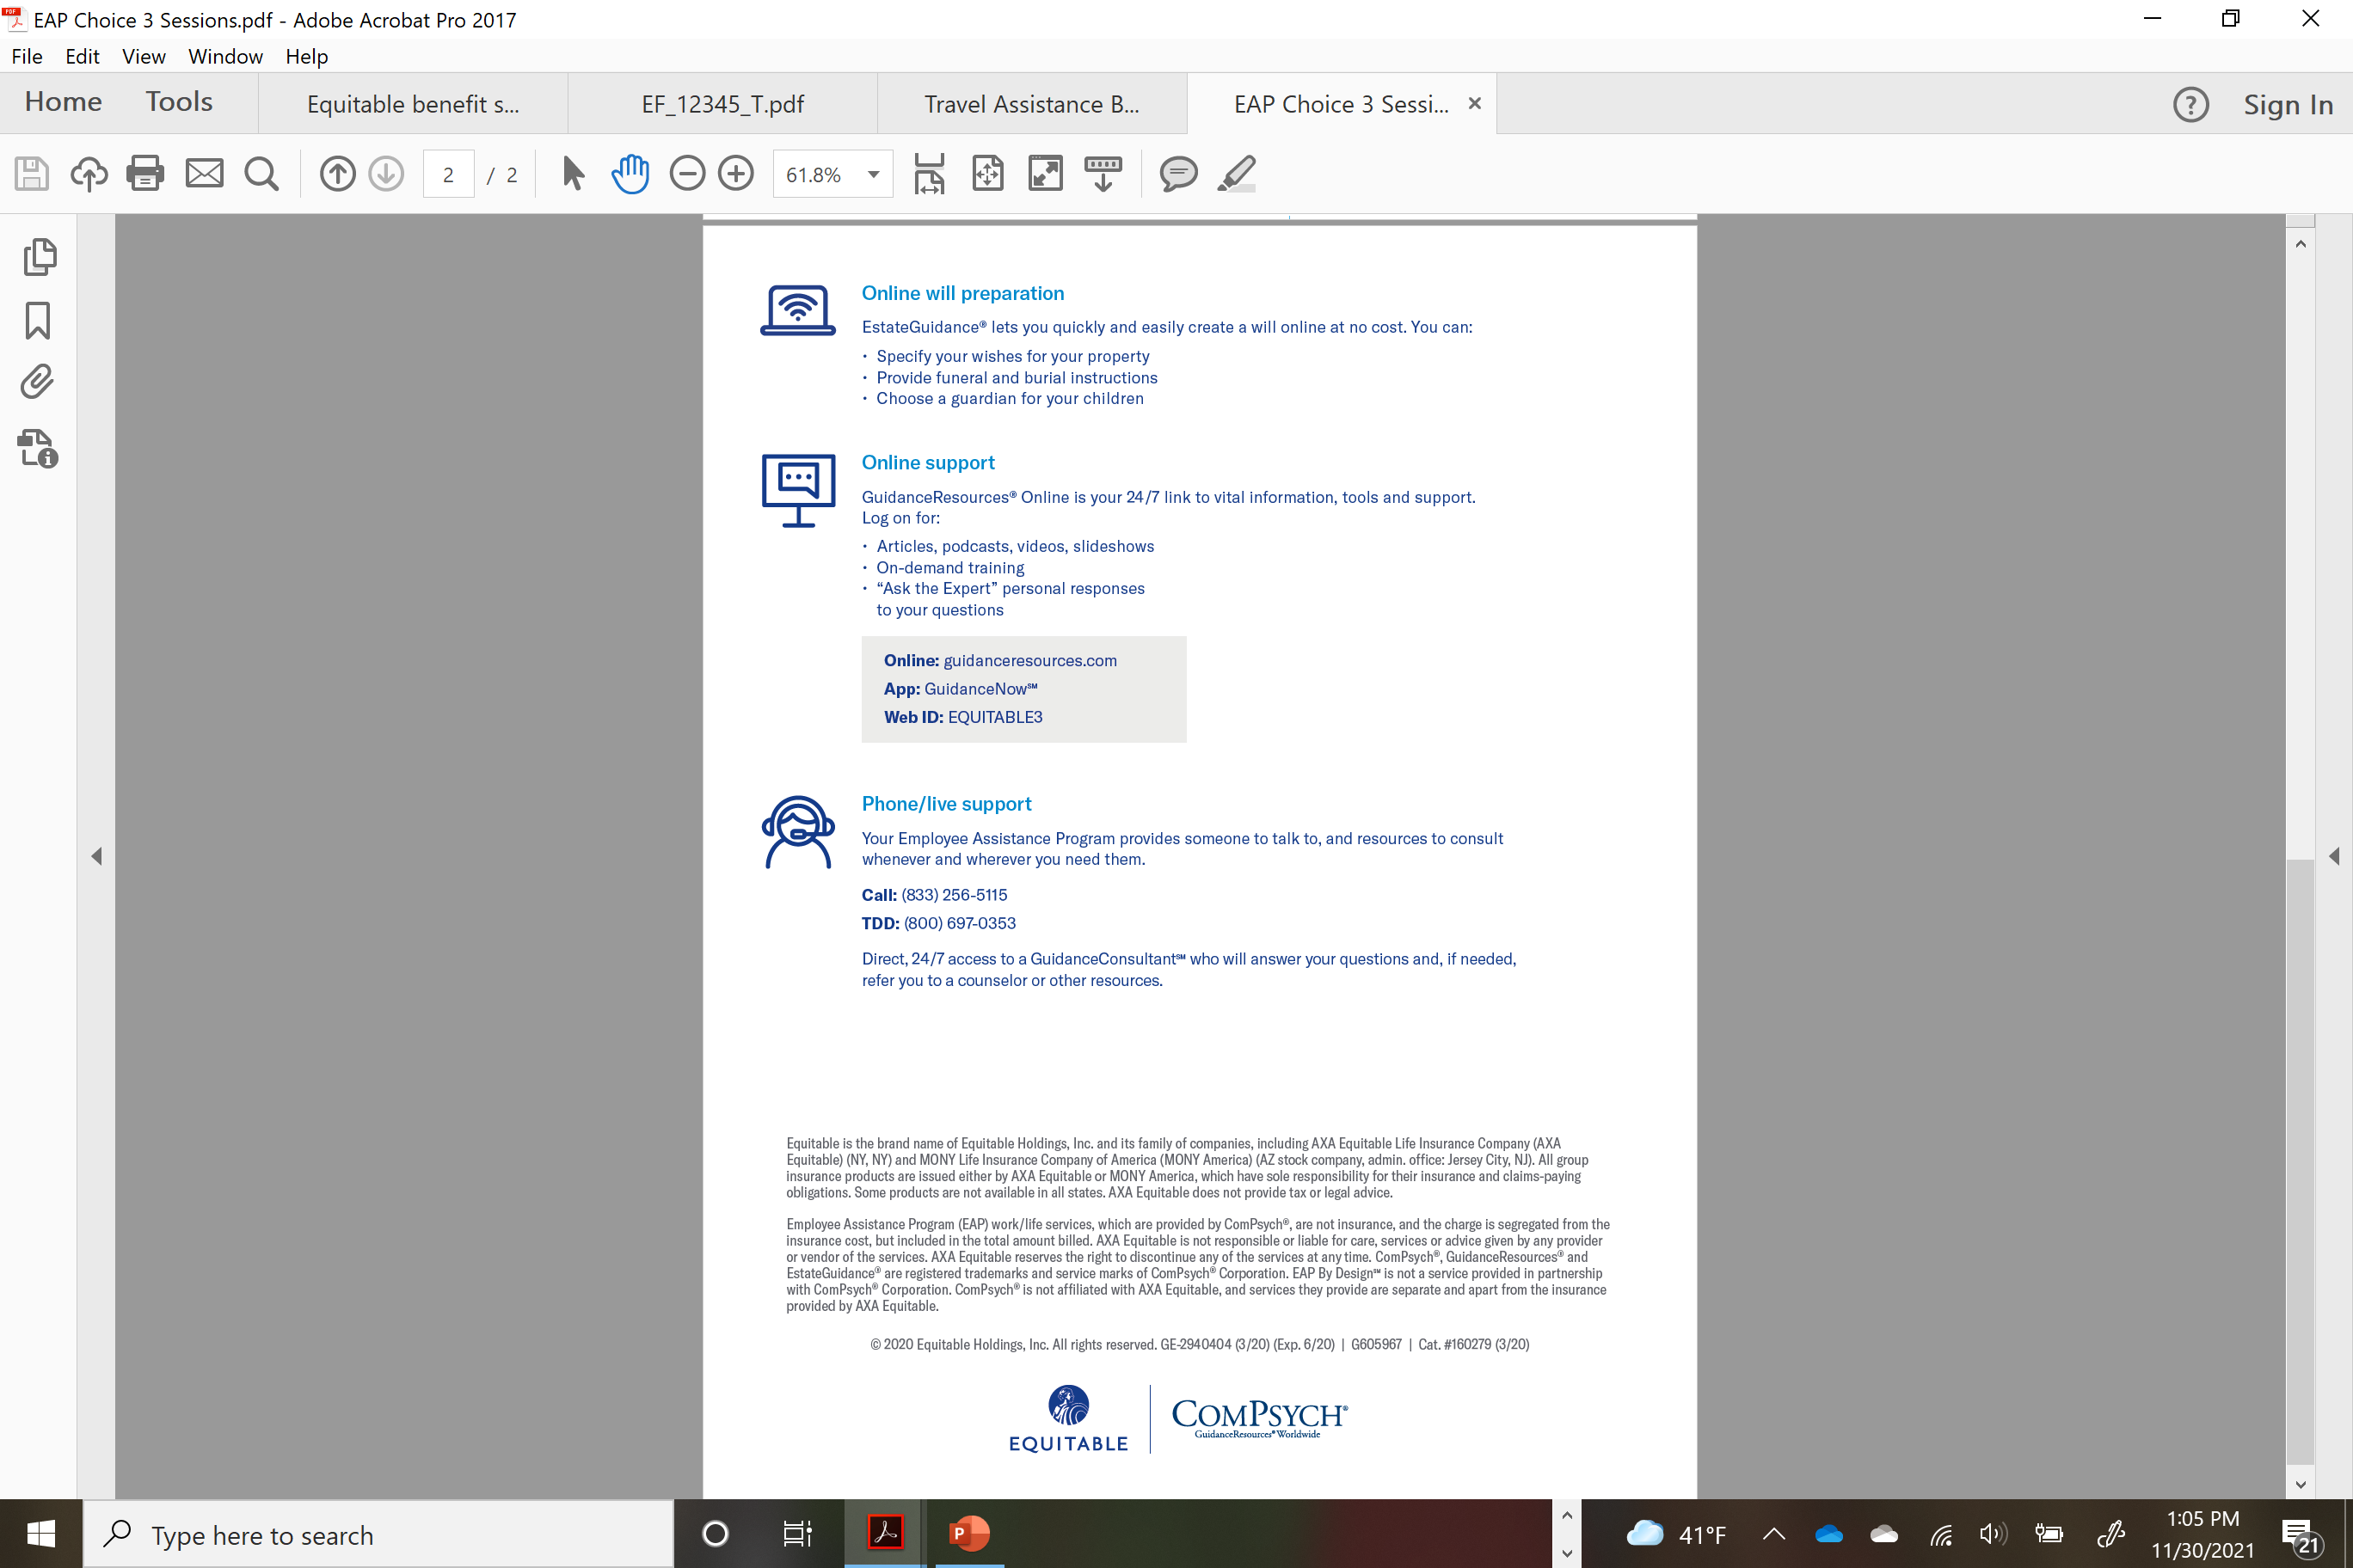
Employee Assistance Program

Slide 19
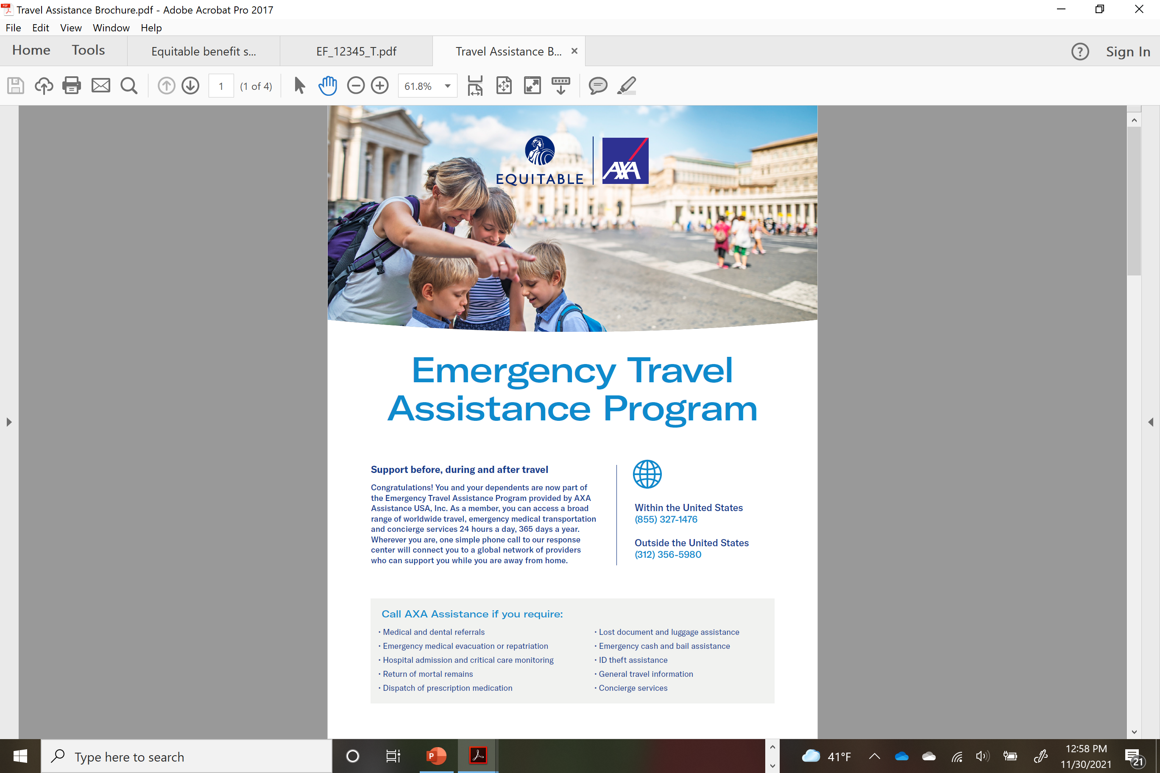
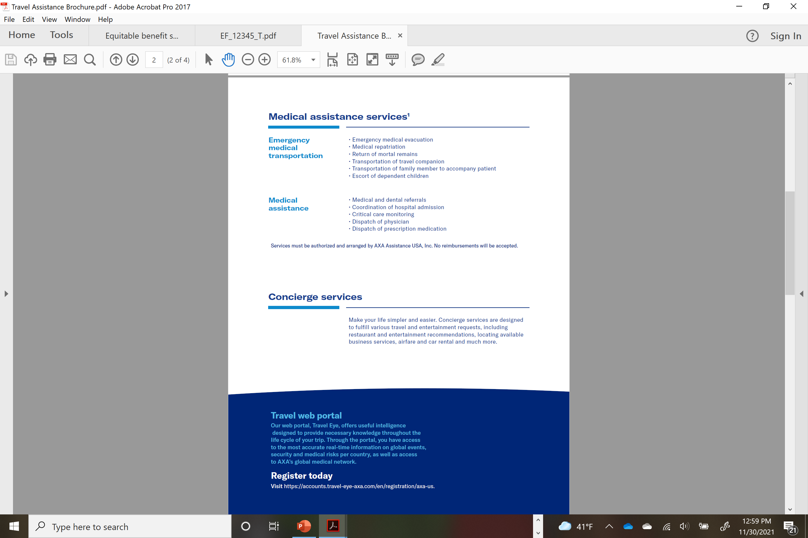
Emergency Travel Assistance Program

Slide 20
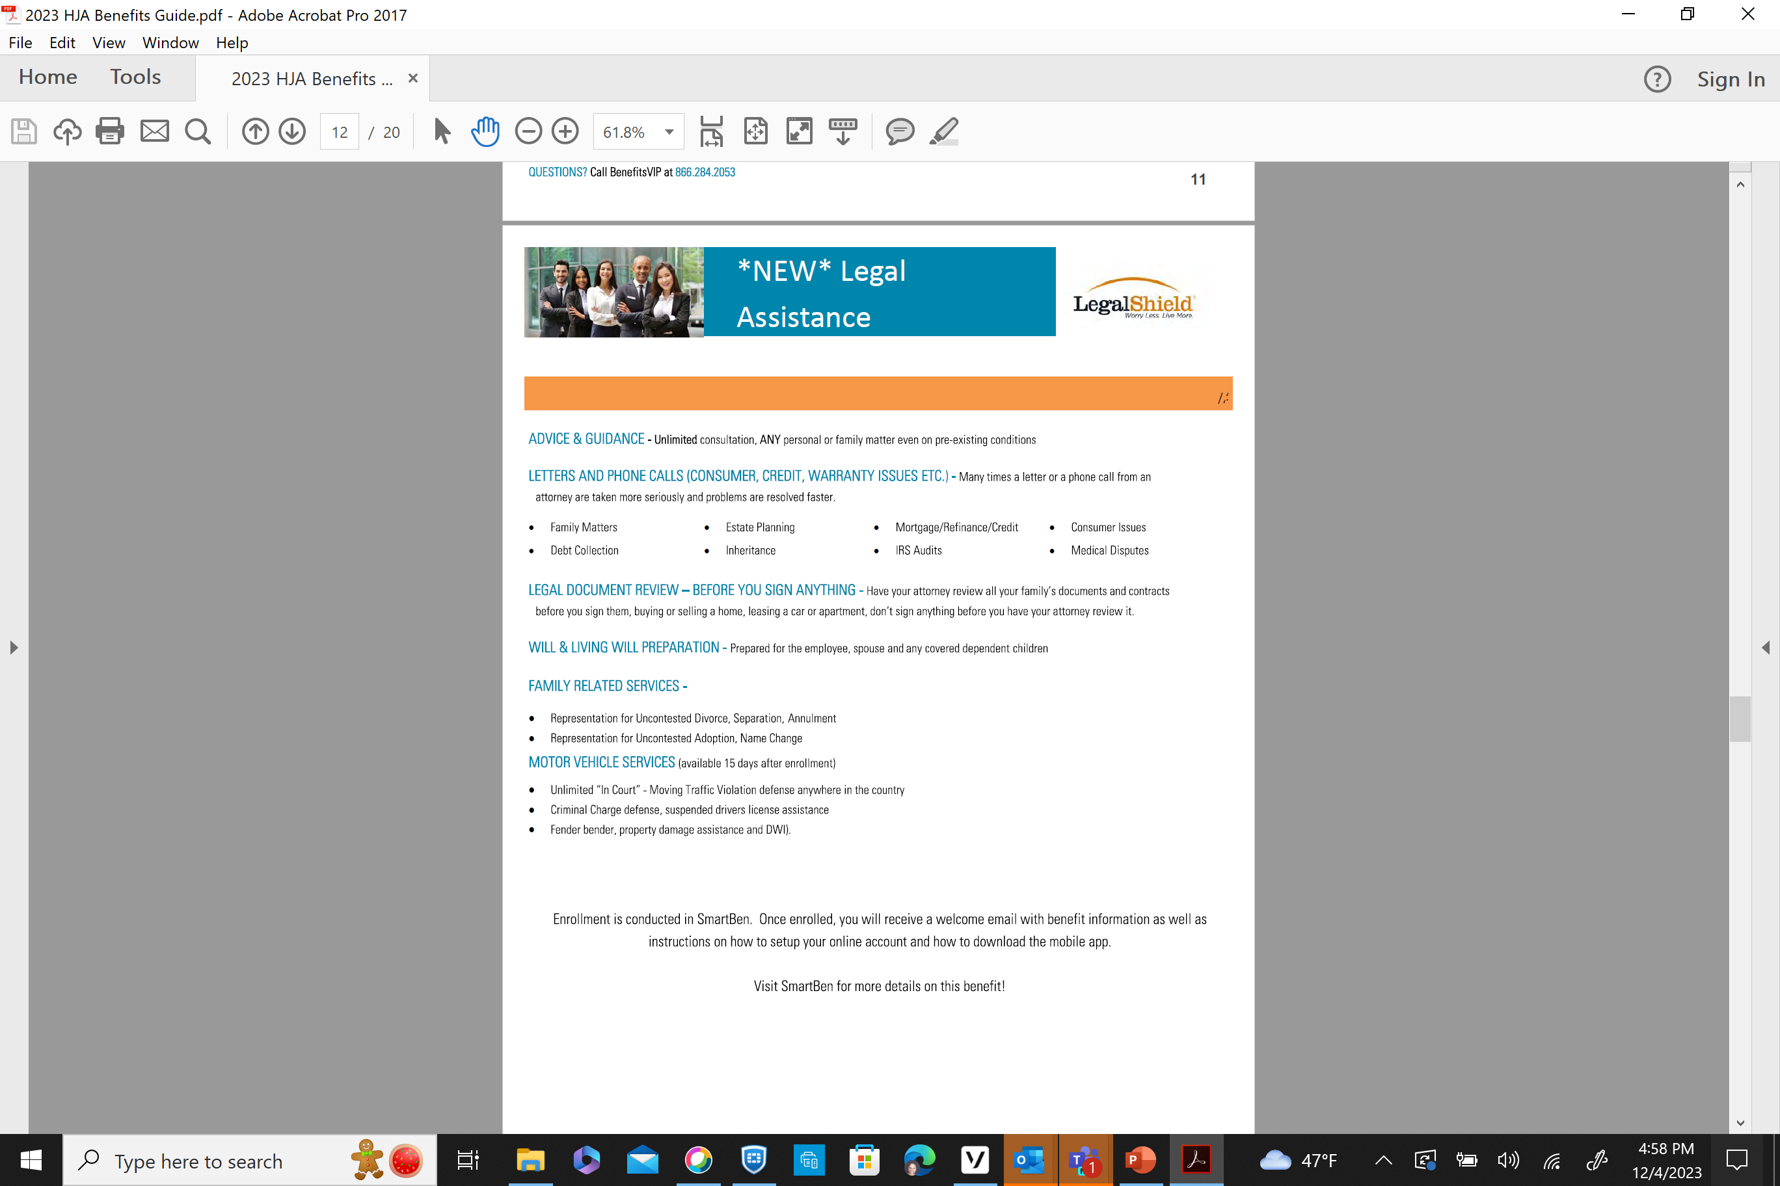
Legal Assistance

Slide 21
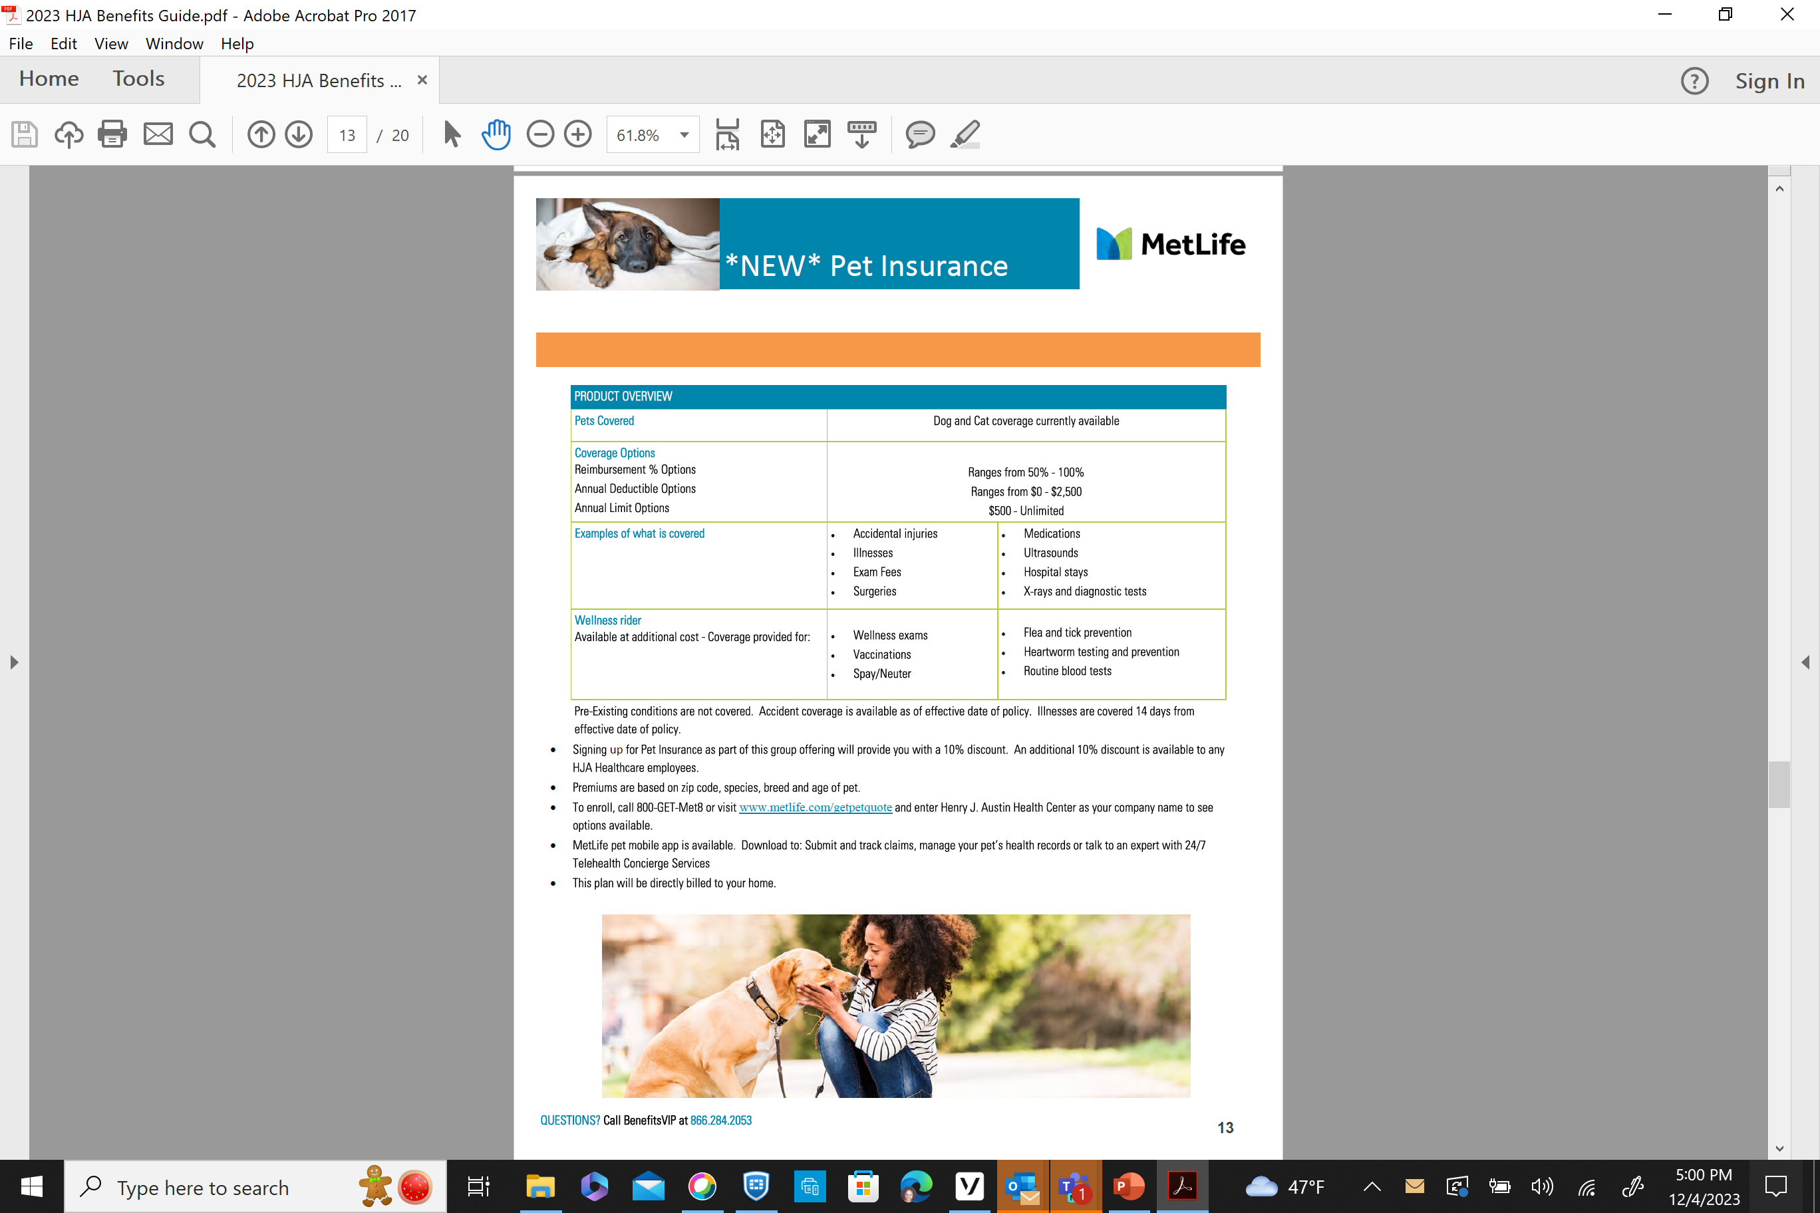
Pet Insurance

Slide 22
Logistics
Enrollments for the current 2023 benefits year will be effective until 12/31/2023.
All new and renewed enrollments will become effective as of 1/1/2024.
All enrollments are done on-line only. Please do not submit any paperwork to HR.
Absolute last date for enrollment changes is December 13, 2023, at 8:00pm. No EXCEPTIONS!
If you have QUESTIONS… Benefits-LIVE is available to assist you 8:30am-8:00pm, Monday through Friday not on weekends. 866-284-2053

Slide 23
Important Contact Information
Seneca Group
Toll Free: 866-487-4157
Claim Fax: 866-207-5262
Claim Email: Service@thesenecagroup.com
Tara King
(866) 487-4157 x 104
fax: (516) 977-3333
email: tara@thesenecagroup.com
BenefitsVIP
866-284-2053
Email: myteam@benefitsvip.com
Maria Santiago- Director of HR
maria.santiago@henryjaustin.org | 609-278-5913
Asia Miles-Shakur – HR/Payroll Administrator
Asia.miles-shakur@henryjaustin.org | 609-278-5916
Nancy Elneus – HR Specialist
nancy.elneus@henryjaustin.org| 609-278-6355
Alaina Stampe – HR Coordinator
Alaina.stampe@henryjaustin.org 609-278-6609

