Slide 1
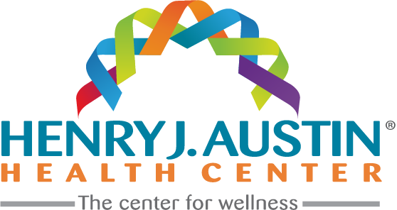
Redefining Community Healthcare

Slide 2
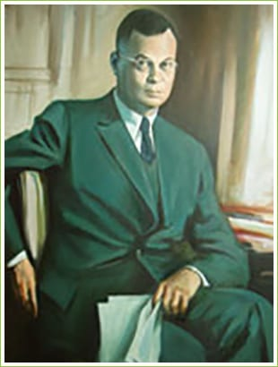
History
Henry J. Austin Health Center (HJAHC) is located in Trenton, New Jersey. Established in 1969 as Trenton’s Neighborhood Health Center, HJAHC was incorporated in 1986 as a private, non-profit 501(c)(3) entity.
Who we are as an organization is steeped in our city's history and the legacy of Dr. Henry J. Austin, and we are honored to be named after him. An African American and Princeton resident, Dr. Austin, came to Trenton to practice medicine because Jim Crow laws prohibited this in his hometown.
Following Dr. Austin’s pledge to provide high-quality health care to those that need it most, Henry J. Austin Health Center has been committed to providing the best care possible for the last five decades. We have been Joint Commission accredited since 1999, and we are a National Committee on Quality Assurance certified Patient-Centered Medical Home since 2013.

Slide 3


Vision and Mission
Henry J. Austin Health Center’s mission is to deliver person-centered and high-quality health care. Working with our community partners, our exceptional team will provide trauma-informed, holistic care to maximize individuals’ strengths and abilities to achieve optimal health and well-being. Henry J. Austin Health Center’s vision as the center for wellness is to inspire our community to attain their highest quality of life.

Slide 4

Our Core Values
Integrity
Compassion
Respect
Cultural Sensitivity
Quality
Integrity forms the foundation that fosters healthy therapeutic relationships that promote healing. Integrity encompasses honesty, keeping one’s word, and consistently adhering to principles of professionalism, even when it is not easy to do so.

Slide 5

Our Core Values
Integrity
Compassion
Respect
Cultural Sensitivity
Quality
Compassion involves responding with kindness and sensitivity to the vulnerability and suffering of others who may be experiencing frightening changes in their lives, with the threat of losing their autonomy, dignity, control over their bodies, and the direction of their future lives.

Slide 6

Our Core Values
Integrity
Compassion
Respect
Cultural Sensitivity
Quality
Respect is listening to what others want, giving them information, and involving them in planning and decision-making, treating them with dignity and respect, and enabling them to have choice and control over their lives and the services they receive.

Slide 7

Our Core Values
Integrity
Compassion
Respect
Cultural Sensitivity
Quality
Culturally Sensitive is described as care that reflects “The ability to be appropriately responsive to the attitudes, feelings, or circumstances of groups of people that share a common and distinctive racial, national, religious, linguistic, or cultural heritage.”

Slide 8

Our Core Values
Integrity
Compassion
Respect
Cultural Sensitivity
Quality
Quality is the extent to which health care services provided to individuals improves their desired health outcomes.

Slide 9
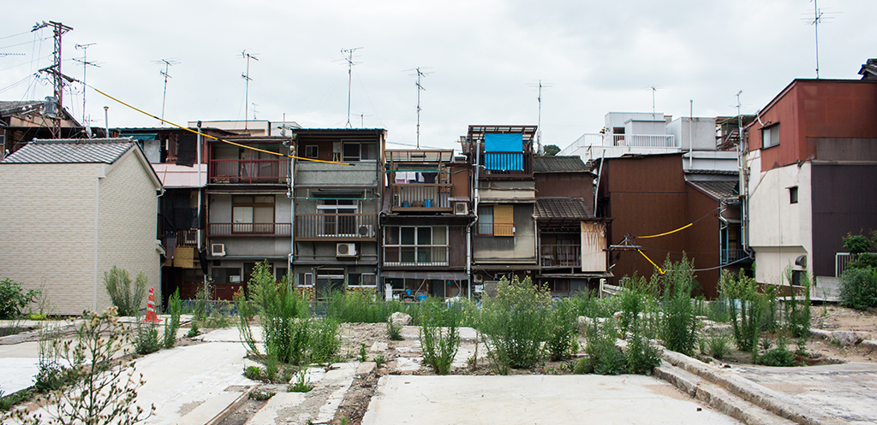

Our Community
Our community experiences significant trauma.
In 2016, more than 40% of children (less than 18 years) statewide had experienced one or more Adverse Childhood Experiences (ACEs), and more than 18% of children had experienced at least two. Among the state’s youngest children (under five years of age), 33% had experienced one or more ACEs. As children in families living in
poverty are particularly vulnerable to ACEs due to food insecurity, housing instability, and other financial stressors, we know that our community members have higher rates of ACEs. These in turn can lead to long-term disparities in health outcomes. Health disparities indicators show a clear need in urban Trenton when compared to the more suburban areas of Mercer County.
ACEs.
Adverse Childhood Experiences

Slide 10
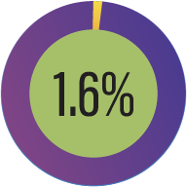
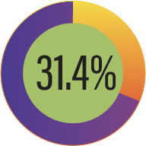
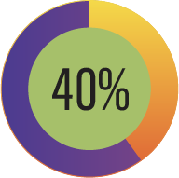
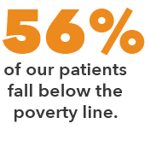
Our Community
While our community has noteworthy strengths, it also has significant challenges to overcome. HJAHC’s service area is concentrated in the city of Trenton with a population of over 82,000. Sectors reflecting strong need in the cities of Lawrence and Hightstown are also included in our service area.
Population of Trenton
82,000
Annual Household
Income
Above
$200,000
People Living Below
The Poverty Line
Children Living Below
The Poverty Line

Slide 11


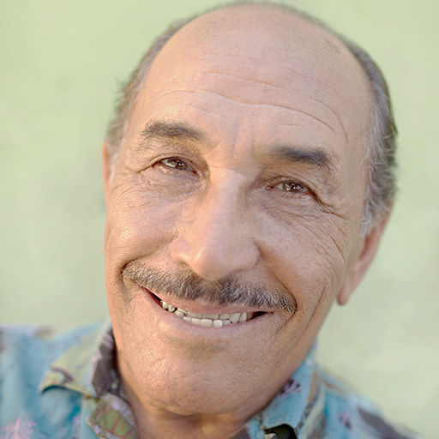


Patient Services
2,500
9,000+
7,000+
2,000+
Other Services
( Nutritional,
Chiropractic, Podiatry )
visits
Behavioral
Health Services
visits
Substance Use
Disorder Services
visits
Dental Services
visits
We serve over 18,000
patients in a year
Medical Services
visits
We performed 11,115
patient screenings in a year
• 5,743 Uninsured
• 9,607 Medicaid
• 1,397 Medicare
• 1,692 Private
45,000
• Cervical Cancer – 1,690
• Breast Cancer – 572
• HIV Screening - 3,280
• Depression Screening
- 5,573

